Slide 1



Air Quality Analysis using Machine Learning
College Name: DKTE, Ichalkaranji.
Student names: Darshan, Pramod, Dinesh
Pritesh, Rushikesh.

Slide 2
Problem Statement
Air pollution poses severe health risks and environmental challenges. This project aims to develop a machine learning model that can predict air quality levels based on historical and real-time environmental data
Brief Overview:
This project analyzes air quality using machine learning techniques to predict pollution levels and identify key contributing factors.
Key Objectives:
Understand variations in air quality over time
Predict pollution levels using ML models
Identify key factors influencing air polluion
Source :
https://github.com/Darshankoli/Air-Quality-Analysis-Using-Machine-Learning

Slide 3
Dataset Overview(Optional)
Dataset Description:
Air quality dataset containing pollutant levels, weather conditions, and timestamps.
Key Features:
PM2.5, PM10, NO2, SO2, CO, O3 concentrations
Temperature, humidity, wind speed, and pressure
Time-based features (hour, day, season)
Size: Varies based on collected data (e.g., months or years of records)
Source :
https://github.com/Darshankoli/Air-Quality-Analysis-Using-Machine-Learning

Slide 4
Methodology
Approach:
Algorithms Used:
Feature Selection & Engineering
Model Training & Evaluation
Data Collection & Preprocessing
Prediction & Analysis
Random Forest (for high accuracy and feature importance)
Support Vector Machine (SVM) (for complex decision boundaries)
Linear Regression (for baseline comparison)
Source :
https://github.com/Darshankoli/Air-Quality-Analysis-Using-Machine-Learning

Slide 5

Conclusion
Summary:
The ML models successfully predicted air quality levels, with Random Forest achieving the highest accuracy. The study helps in forecasting pollution trends and making data-driven decisions for pollution control.
Future Work:
Enhancing real-time data analysis with IoT sensors
Implementing deep learning techniques for better predictions
Developing a user-friendly dashboard for real-time monitoring
Source :
https://github.com/Darshankoli/Air-Quality-Analysis-Using-Machine-Learning

Slide 6
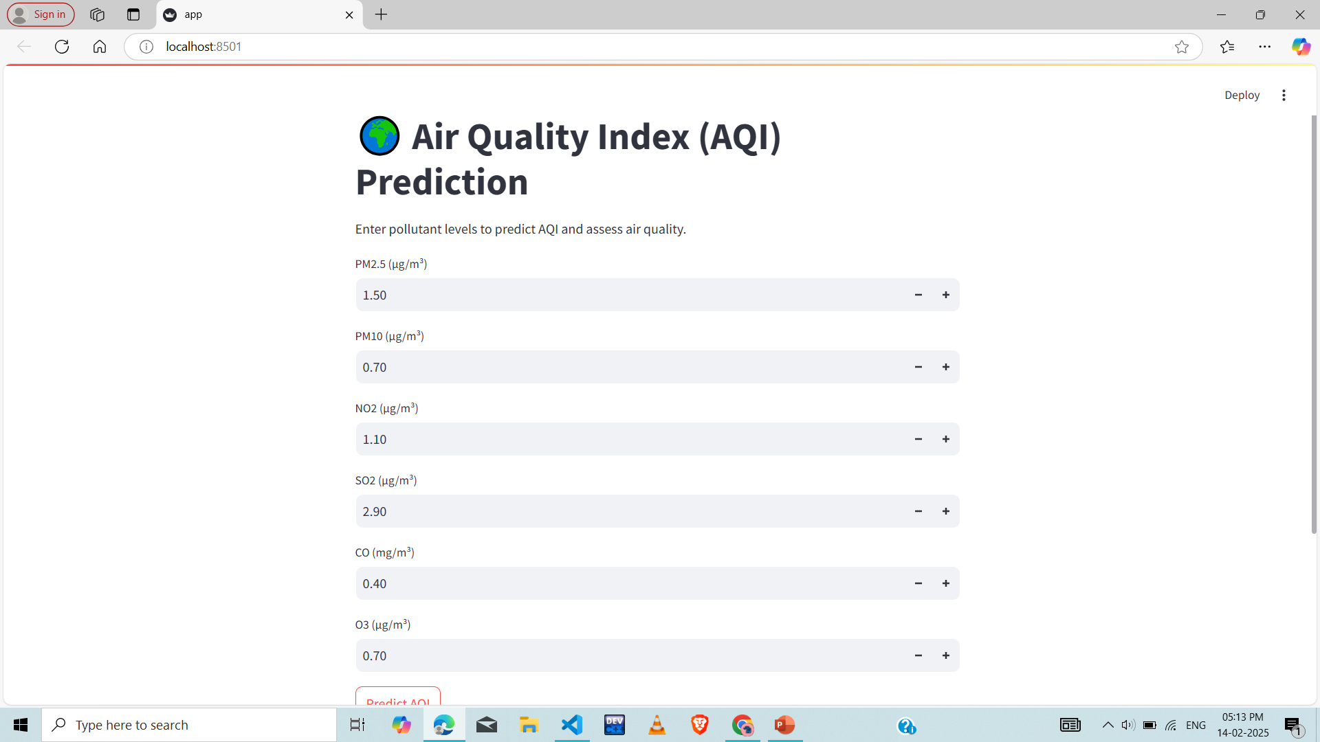
Result

Slide 7
Thank You
Notes:
Thank You !!

